Slide 1
CORONA VIRUS ANALYSIS USING SQL
KRISHNA PRAJAPATI

Slide 2
OVERVIEW
As a data analyst, our job is to dig into the information about COVID-19 and figure out what it's telling us. We're like detectives, but instead of solving crimes, we're trying to understand how the virus is spreading and how it's affecting people. By looking at the numbers and trends, we can help make decisions about how to deal with the pandemic and keep people safe.

Slide 3
DATASET INFORMATION DESCRIPTION OF EACH COLUMN IN DATASET
Province: Geographic subdivision within a country/region.
Country: Geographic entity where data is recorded.
Latitude: North-south position on Earth's surface.
Longitude: East-west position on Earth's surface.
Date: Recorded date of CORONA VIRUS data.
Confirmed: Number of diagnosed CORONA VIRUS cases.
Deaths: Number of CORONA VIRUS related deaths.
Recovered: Number of recovered CORONA VIRUS cases.

Slide 4
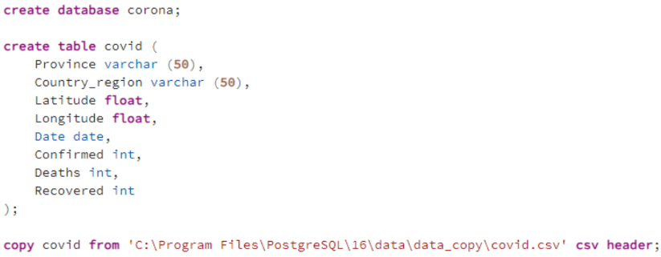
00. Create Database, Create Table, Import csv dataset into PostgreSQL

Slide 5
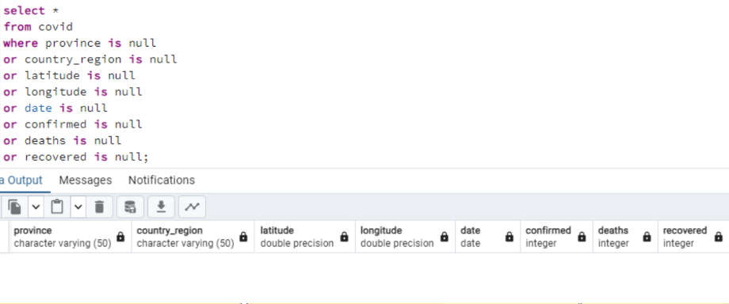
01. Write a code to check for NULL values

Slide 6
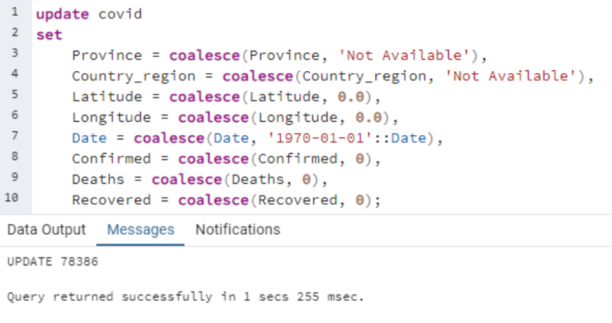
02. If NULL values are present, update them with zeros for all columns

Slide 7
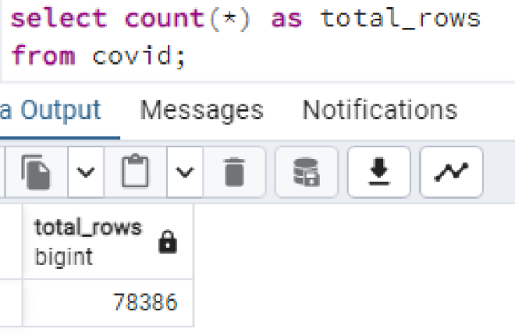
03. Check Total number of rows

Slide 8
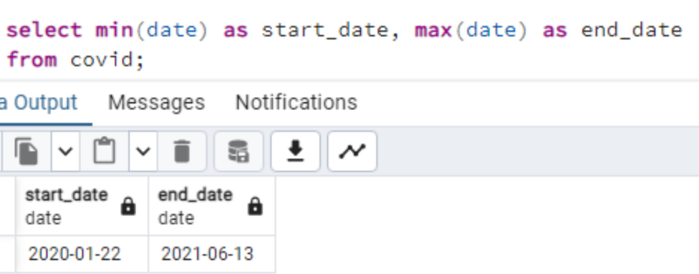
Q4. Check what is start_date and end_date

Slide 9
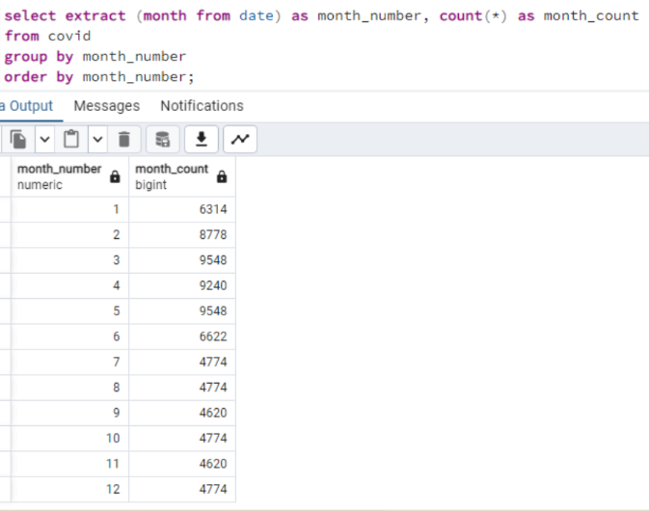
05. Number of month present in Dataset

Slide 10
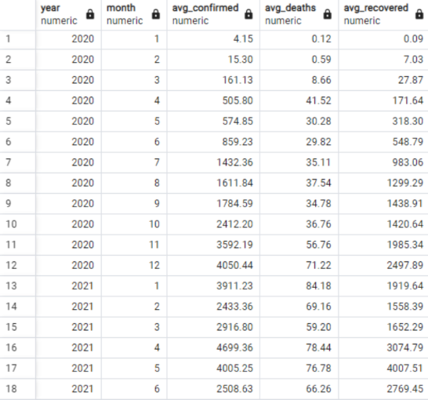
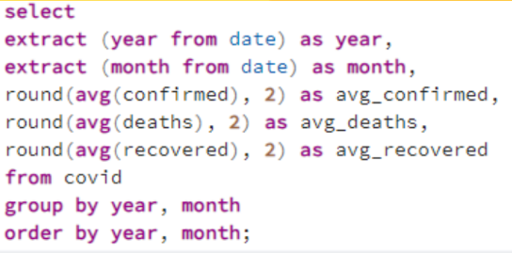
06. Find monthly average for confirmed , deaths and recovered

Slide 11
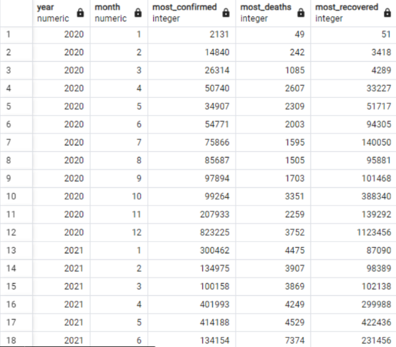
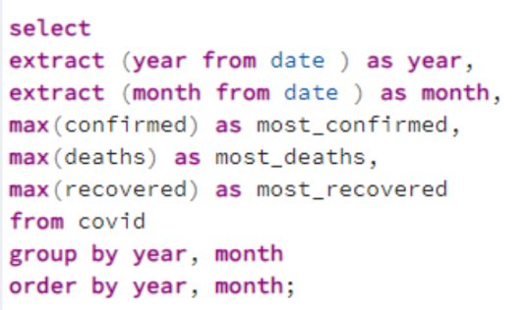
07. Find most frequent value for confirmed , deaths, recovered each month

Slide 12
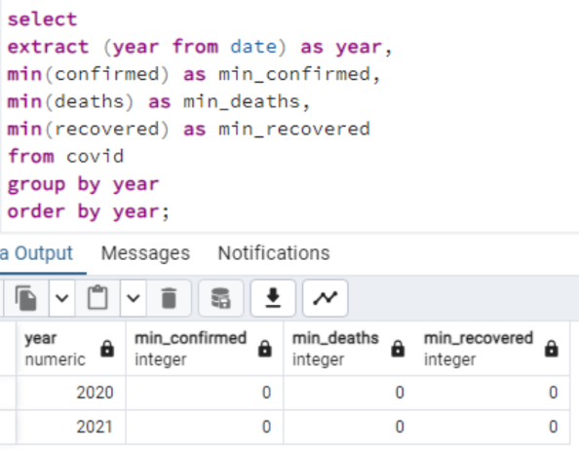
08. Find minimum values for confirmed , deaths , recovered per year

Slide 13
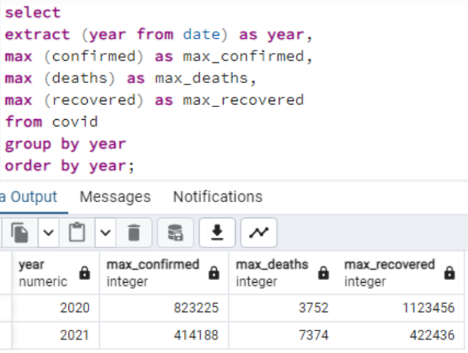
09. Find maximum values for confirmed , deaths , recovered per year

Slide 14
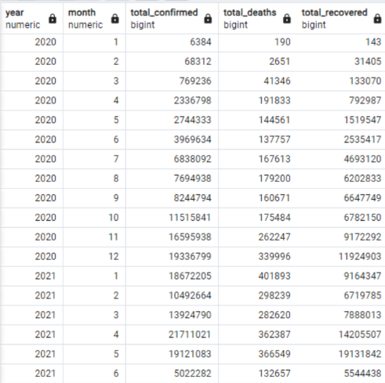
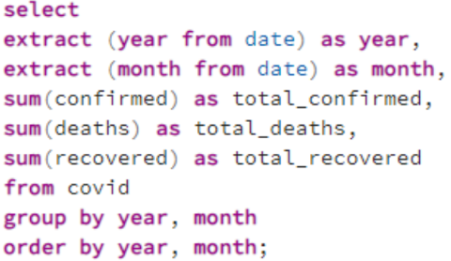
10. Find total number of cases of confirmed , deaths , recovered each month

Slide 15
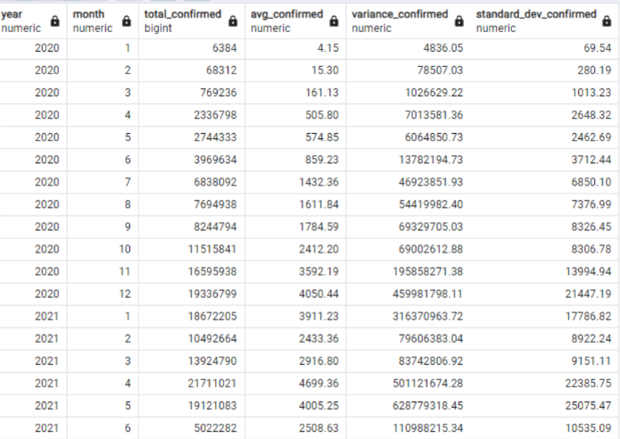
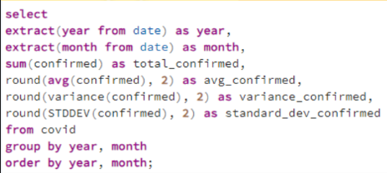
11. Check how corona virus spread out with respect to confirmed cases

Slide 16
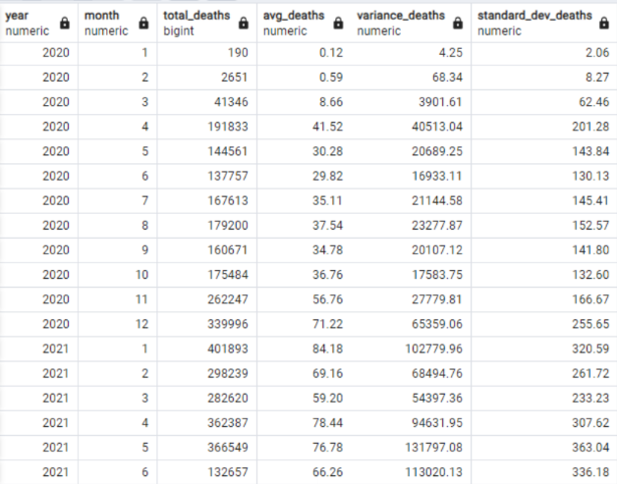
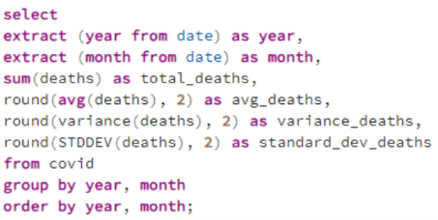
12. Check how corona virus spread out with respect to death case per month

Slide 17
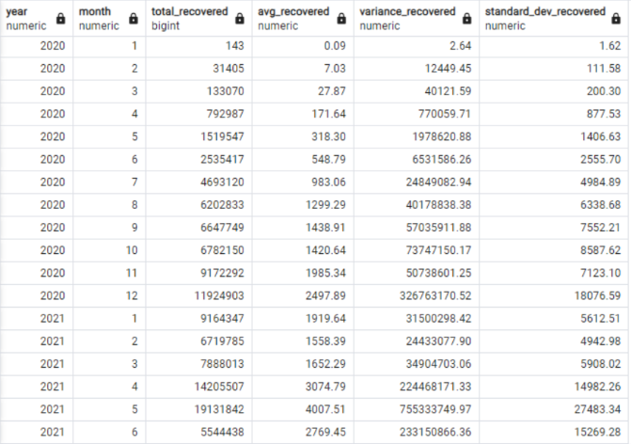
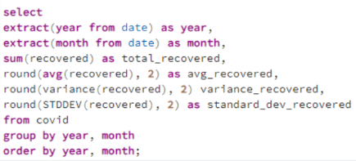
13. Check how corona virus spread out with respect to recovered cases

Slide 18
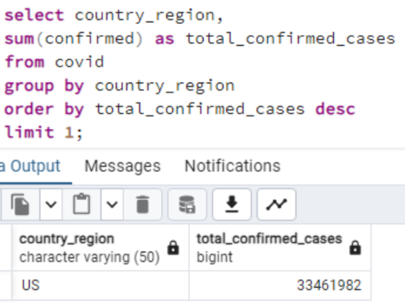
14. Find the Country have highest number of confirmed cases

Slide 19
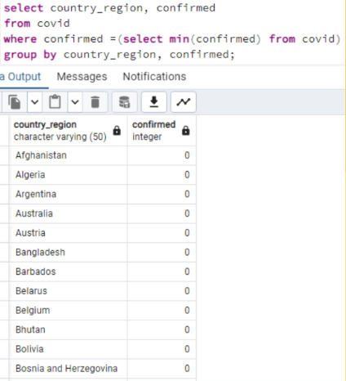
15. Find the Country have lowest number of death cases

Slide 20
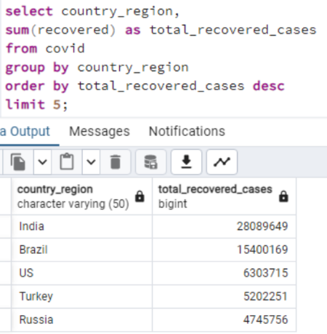
16. Find top 5 countries have highest recovered cases.

Slide 21
1. COVID-19 Pandemic started from 22 January 2020 stayed till 13 June 2021. 2. India has the Highest number of recovered cases. 3. Samoa, Kiribati, Dominica, and The Marshall Islands have the lowest number of Deaths. 4. The US leads in confirmed COVID-19 cases. 5. Peak confirmed cases recorded in April 2021. 6. Peak death recorded in January 2021.
Insights

Slide 22
THANK YOU

